Slide 1

Exploratory Data Analysis
Dataset – ANZ Transaction Data
Tools- Tableau Public

Slide 2
About the Dataset -
The Dataset given to us is a synthesized transaction dataset by ANZ .
The Dataset contains 3 months worth data from August 2018 to September 2018 of about a 100 hypothetical customers.
The dataset has about 12043 transactions .
The dataset has 23 different features about each transaction like the transaction id, customer id, transaction type, merchant state, date of transaction.
Our main aim here is to explore the dataset and to find any interesting insights that may interest ANZ's management team.

Slide 3
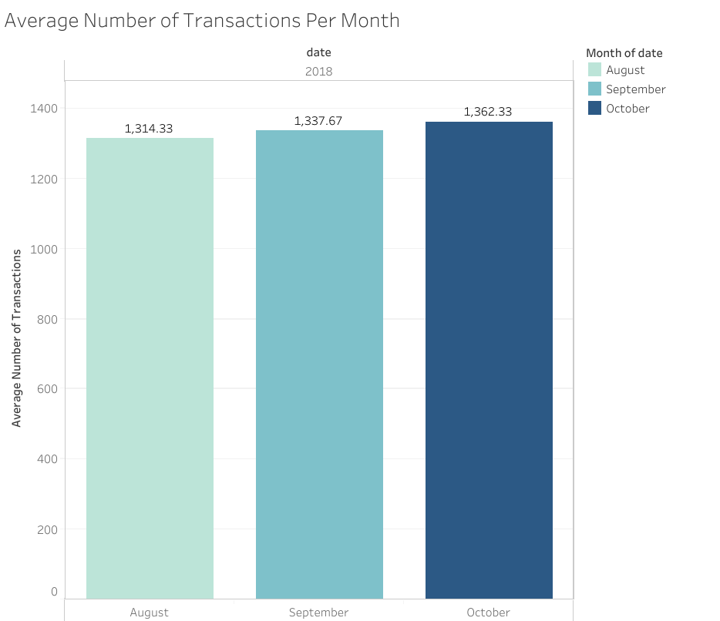
This graph shows the average number of Transactions per month.
The average number of Transactions are almost similar for each month , October has the highest average number of transactions at 1362 .

Slide 4
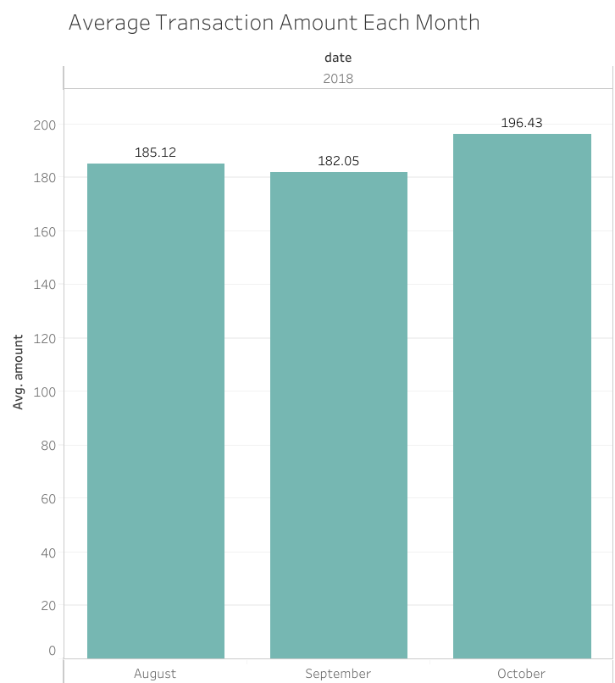
This graph shows the average Transaction amount per month
Again like seen in the previous graph the average amount per Transactions are almost similar for each month with October being the highest at 196.43 AUD.

Slide 5
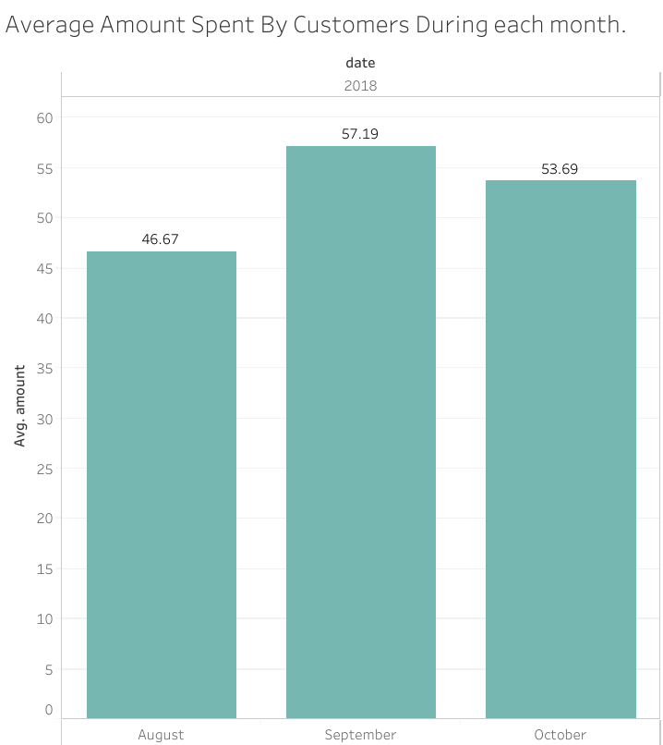
This graph shows the average amount spent by each customer during each month.
September has the highest average expenditure at 57.19 AUD.

Slide 6
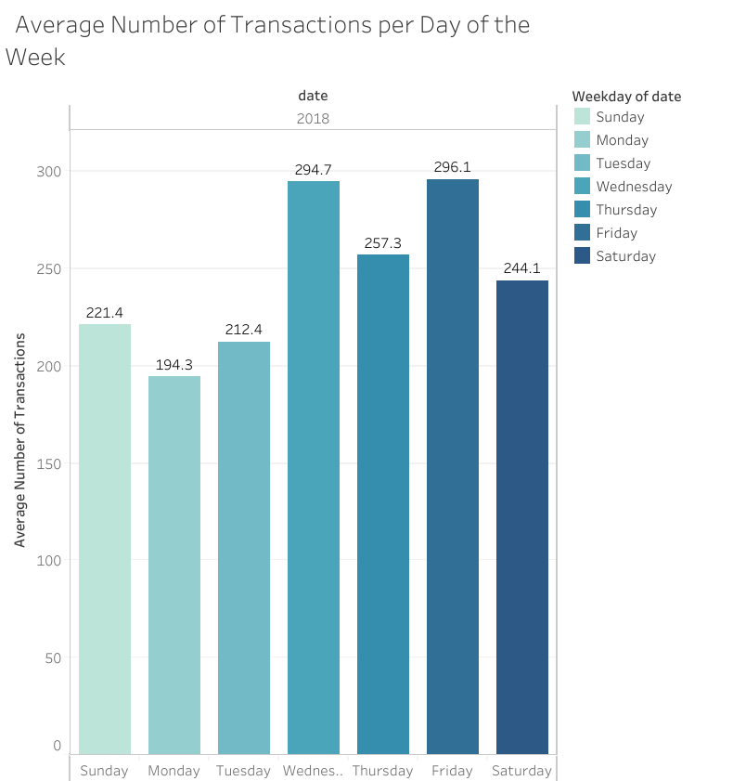
This graph shows the average number of Transactions during each day of the week.
Friday has the highest average at 296 transactions closely followed by Wednesday.
Monday has the lowest average at 194.3.

Slide 7
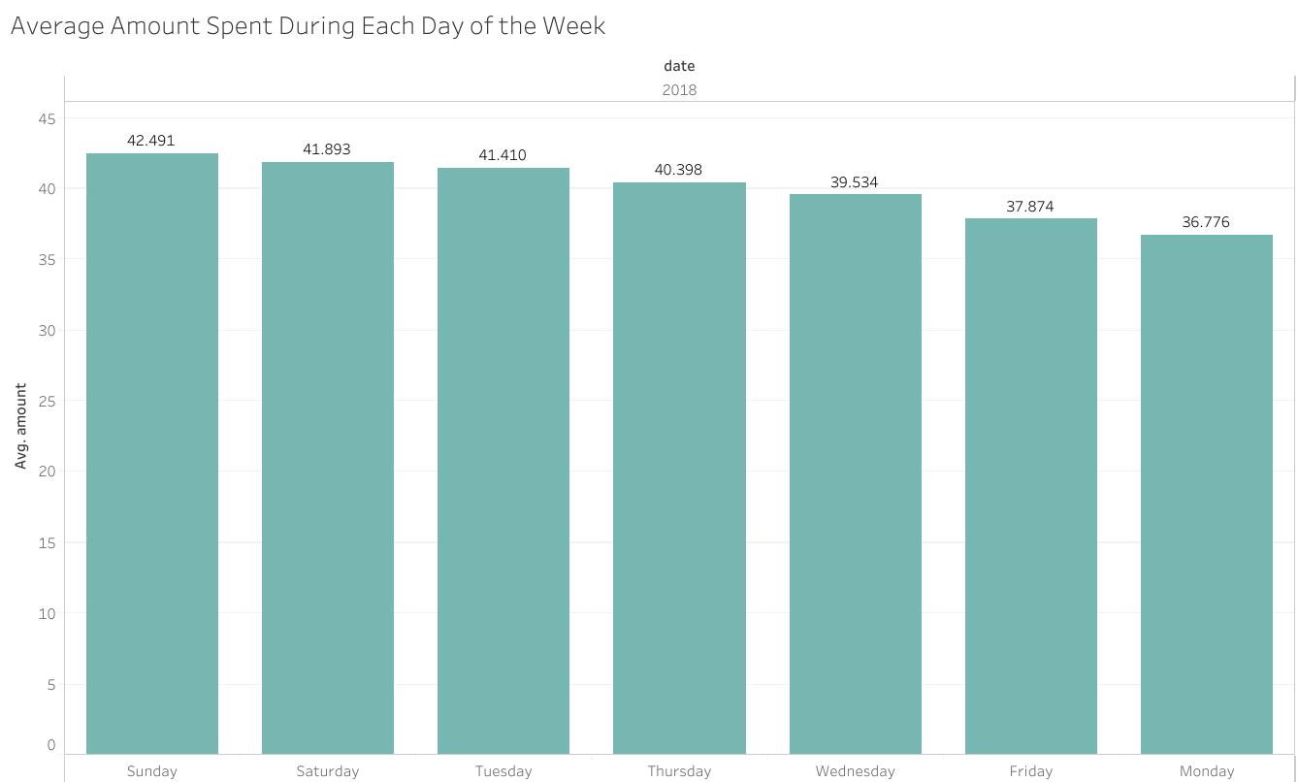
The graph shows on what days the customers spend the most amount of money and as you can see Sunday and Saturday have the highest average amount spent as people tend to spend more during the weekends.

Slide 8
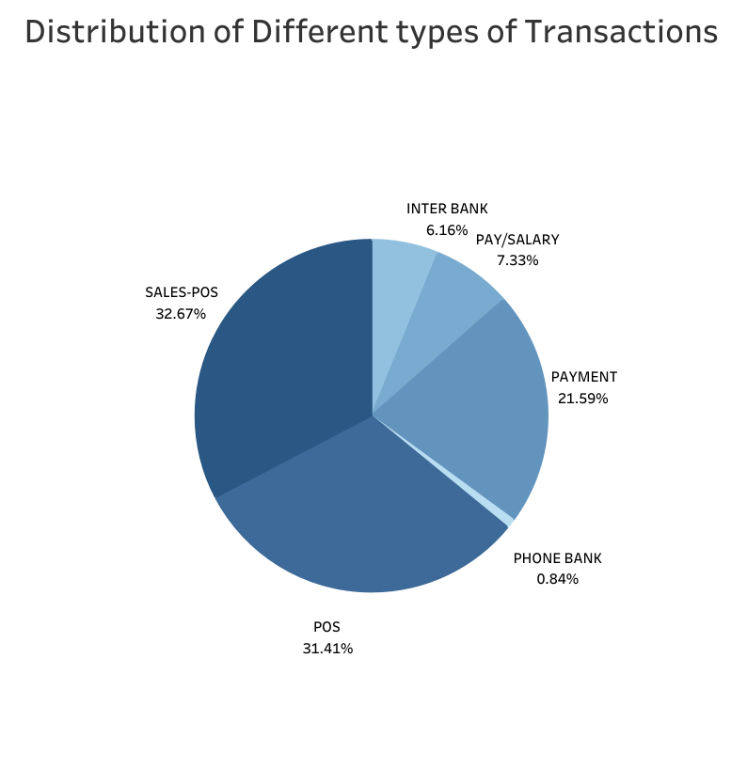
The pie chart here shows the distribution of all transactions across different types.
Point of Sales(POS) and Sales-POS have the maximum share at 31% and 32% respectively.
Phone Banking seem to have a low number showing that customers may not be using the phone banking services.

Slide 9
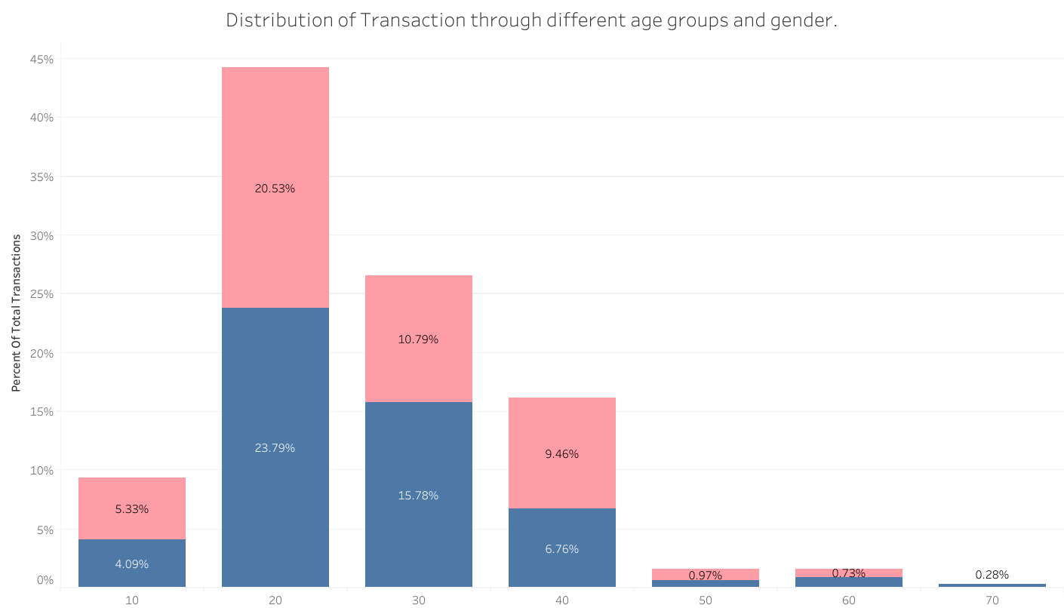
The above graph shows distribution of customers across age and gender. The maximum customers are between the ages of 20-50 and distributed almost evenly across both genders.

Slide 10
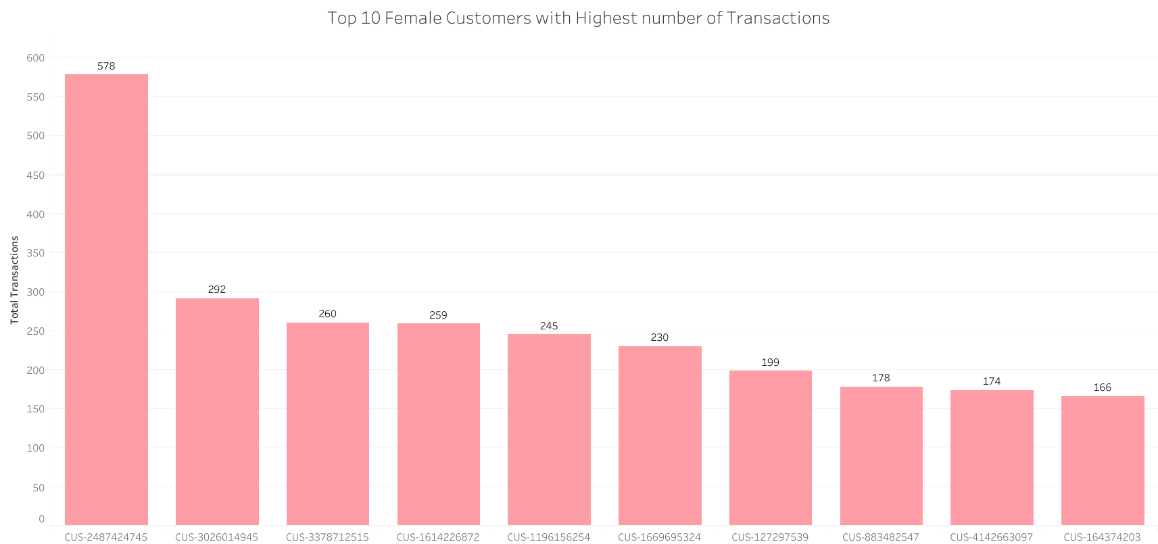
The above graph shows the top 10 female customers according to transactions. Customer No –2487424745 has the highest transaction at 578 transactions during the given period.

Slide 11
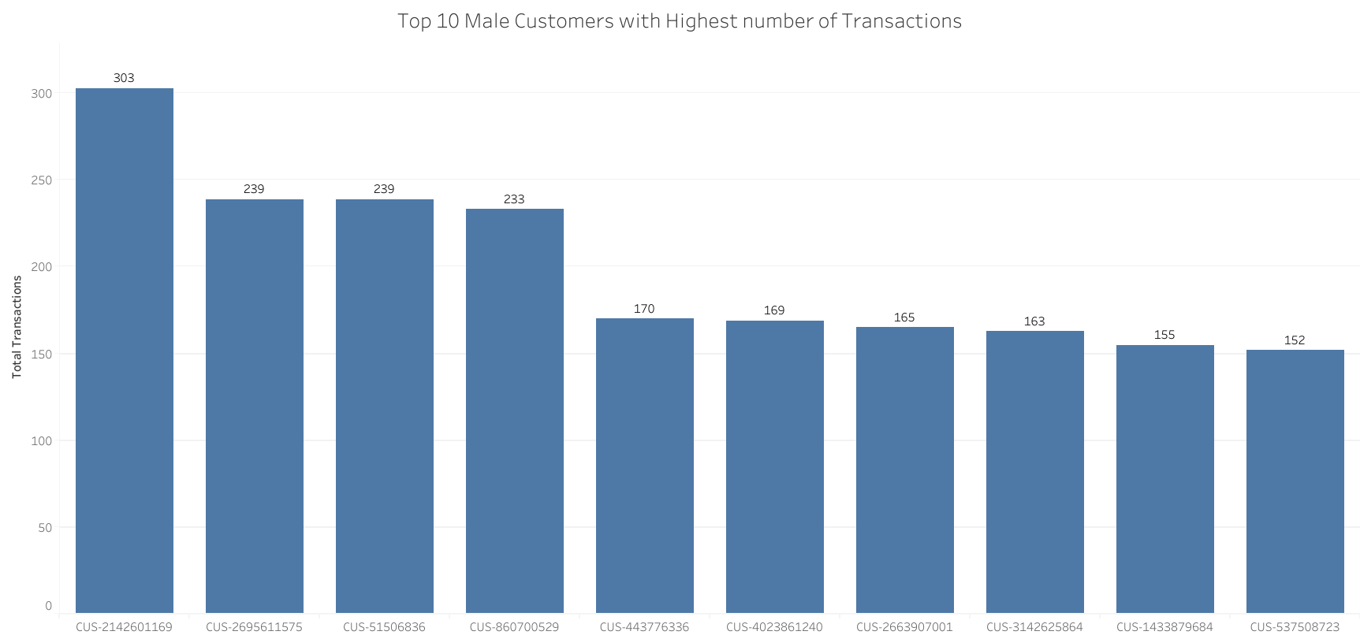
The above graph shows the top 10 male customers according to transactions. Customer No –2142601169 has the highest transaction at 303 transactions during the given period.

Slide 12
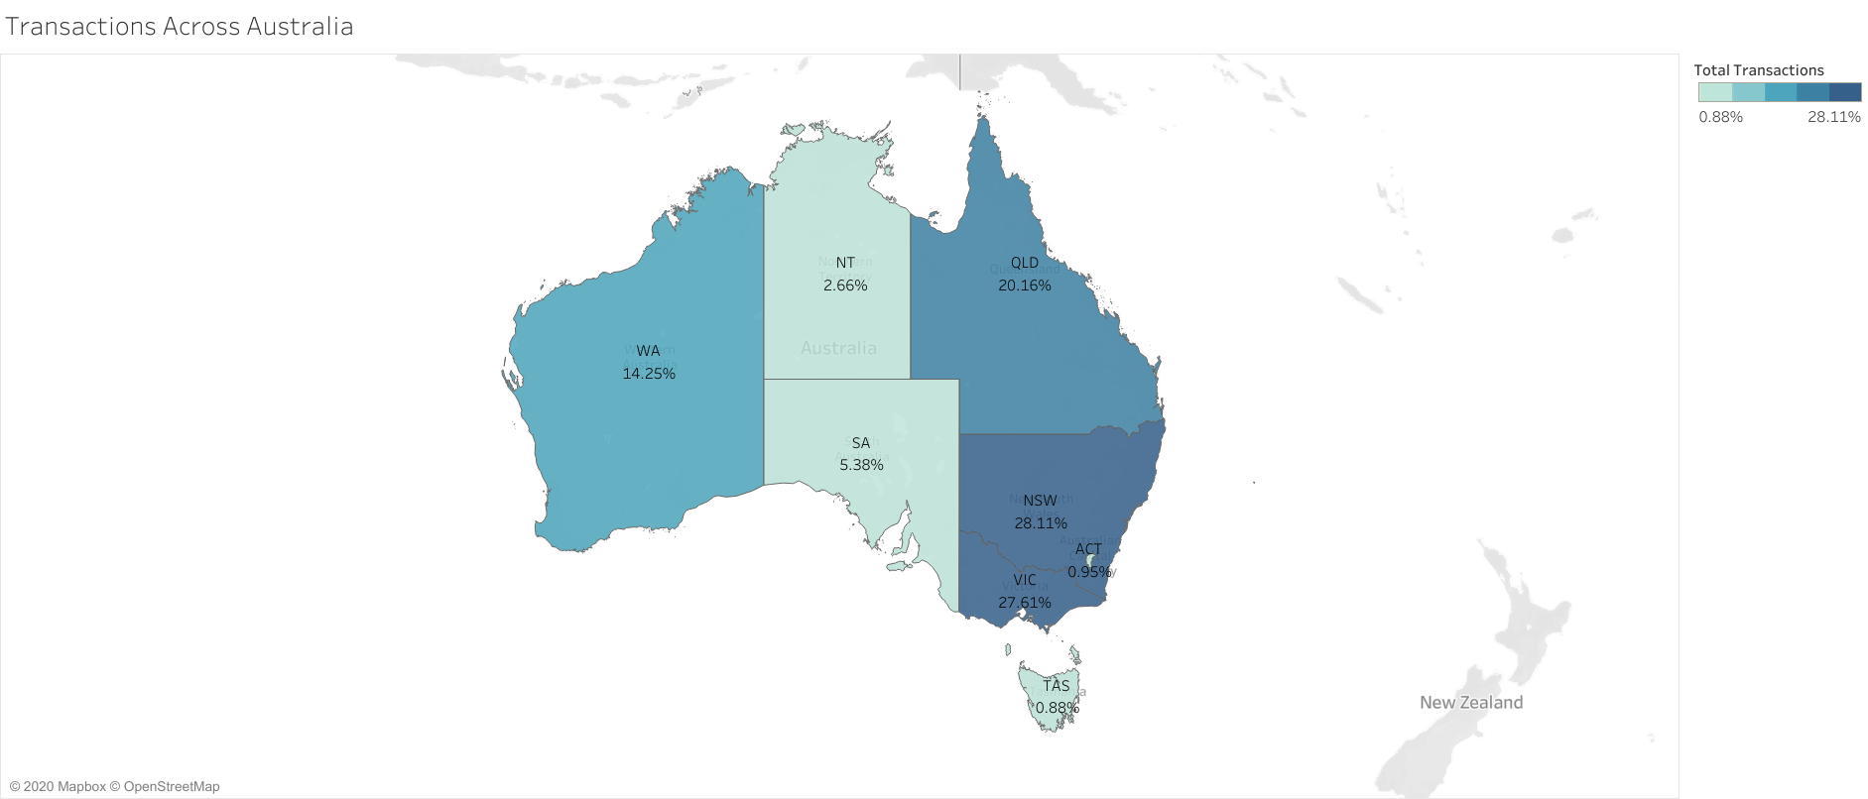
Distribution of Transactions Across Australia
The states of New South Wales and Victoria have the most number of transactions followed by Queensland and Western Australia.
Tasmania has the lowest number of transactions across all states.

